Slide 1

Association and Causation

Slide 2
Evaluation of preventive measures
How much will it benefit the community ?
Effectiveness of the preventive measure and the acceptance of the measure by the community.
The combined outcome of effectiveness and acceptability is measured by the difference in the incidence rate among the experimental and control groups,
What are the risks to the recipients?
Immediate and long-term risks,
Cost in money and manpower?
This is done to find out whether the preventive measure is economical and practical in terms of money spent.

Slide 3
Definition
Association - Concurrence of two variables more often than would be expected by chance.
Correlation indicates the degree of association between two characteristics. The correlation coefficients range from -1.0 to +1.0.
Correlation cannot be used to invoke causation, because the sequence of exposure preceding disease (temporal association) cannot be assumed to have occurred. Secondly, correlation does not measure risk.
It may be said that causation implies correlation, but correlation does not imply causation.

Slide 4
Types
Spurious association
Indirect association
Direct (causal) association
One-to-one causal association
Multifactorial causation

Slide 5
Spurious association
A study in UK of 5174 births at home and 11,156 births in hospitals showed perinatal mortality rates of 5.4 per 1000 in the home births, and 27.8 per 1000 in the hospital births.
This type of bias where “like” is not compared with “like” (selection bias) is very important in epidemiological studies. It may lead to a spurious association or an association when none actually existed.

Slide 6
Indirect association
Many associations which at first appeared to be causal have been found on further study to be due to indirect association.
The indirect association is a statistical association between a characteristic (or variable) of interest and a disease due to the presence of another factor, known or unknown, that is common to both the characteristic and the disease.
E.g. – Altitude and endemic goitre
- Sucrose and CHD

Slide 7
One – to – one causal relationship
Two variables are stated to be causally related (AB) if a change in A is followed by a change in B.
This model suggests that when the factor A is present, the disease B must result. Conversely, when the disease is present, the factor must also be present.
The above concept of one-to-one causal relationship was the essence of Koch’s postulates. The proponents of the germ theory of disease insisted that the cause must be :
a. necessary
b. sufficient for the occurrence of disease

Slide 8
Multifactorial causation
Causal factors can act independently
- Lung cancer
Causal factors act cumulatively (synergistic effect)
- CHD
** In biological phenomena, the requirement that “cause” is both “necessary” and “sufficient” condition is not easily reached, because of the existence of multiple factors in disease aetiology. This has created a serious problem to the epidemiologist, who is in search of causes of disease.

Slide 9
Hill’s Criteria of causal association
Temporality
Strength of association
Consistency
Biological gradient
Biological plausibility
Experimental evidence
Laboratory proof
Analogy
Specificity
Coherence

Slide 10
Should be fulfilled
Temporality,
Strength of association
Consistency
Temporality – suspected cause preceded the outcome

Slide 11
Lend additional strength
Biological gradient – increasing dose of exposure should be associated with increasing occurrence of outcome
Biological plausibility – cause effect should stand to reasoning
Experimental evidence
Laboratory proof

Slide 12
May be considered
Analogy – one cause has been shown to result in particular effect, same cause is most likely to result into other effect of similar nature
Specificity – for particular effect, there should be one and only exclusive cause
Coherence – findings should not be in conflict with known history of disease

Slide 13
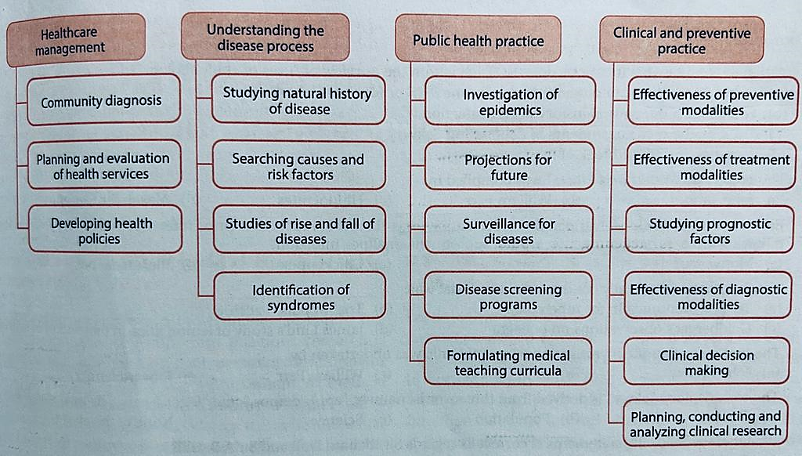
Uses of epidemiology

Slide 14
Investigation of an epidemic
Verification of diagnosis
Confirmation of the existence of an epidemic
Defining the population at risk
Rapid search for all cases and their characteristics
Data analysis
Formulation of hypotheses
Testing of hypotheses
Evaluation of ecological factors
Further investigation of population at risk
Writing the report

Slide 15
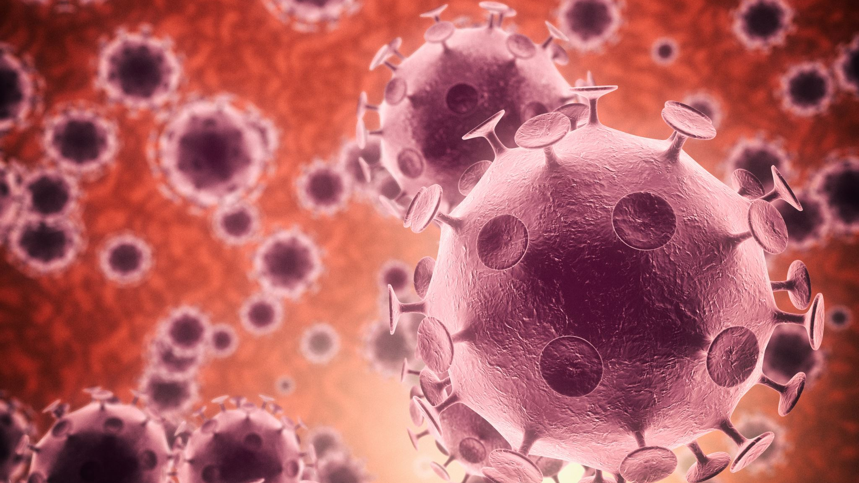
Infectious disease epidemiology

Slide 16
Operational definitions
Infection - The entry and development or multiplication of an infectious agent in an organism, including the body of man or animals. It also implies that the body responds in some way to defend itself against the invader, either in the form of an immune response or disease.
Colonization
Subclinical
Latent infection
Clinical infection
Contamination - The presence of an infectious agent on a body surface also on or in clothes, beddings, toys, surgical instruments or dressings, or other inanimate articles or substances including water, milk and food.
Infestation - For persons or animals the lodgment, development and reproduction of arthropods on the surface of the body or in the clothing

Slide 17
Host - A person or other living animal, including birds and arthropods, that affords subsistence or lodgement to an infectious agent under natural (as opposed to experimental) conditions.
Obligate host
Definitive hosts
Intermediate hosts
Transport host
Infectious disease - A disease due to an infectious agent. While some infectious diseases are contagious, others are noncontagious. All infectious diseases and infestations are communicable diseases
Contagious disease
Communicable disease - An illness due to a specific infectious agent or its toxic products that arises through transmission of that agent or its products from an infected person, animal, or reservoir to a susceptible host, either directly or indirectly through an intermediate plant or animal host, vector, or the inanimate environment

Slide 18
EPIDEMIC - [Epi (upon), demos (people)]. The occurrence in a community or region of cases of an illness, specific health related behaviour, or other health-related events clearly in excess of normal expectancy.
Epidemicity is thus relative to usual frequency of the disease in the same area, among the specified population, at the same season of the year.
ENDEMIC - (En = in; demos=people). It refers to the constant presence of a disease or infectious agent within a given geographic area or population group, without importation from outside; may also refer to the “usual” or expected frequency of the disease within such area or population group.
Hyper-endemic
Holo – endemic

Slide 19
SPORADIC – scattered; The cases occur irregularly, haphazardly from time to time, and generally infrequently
PANDEMIC - An epidemic occurring over a very wide area, crossing international boundaries, and usually affecting many people. Only some pandemics cause severe disease in some individuals or at a population level.
Characteristics of an infectious agent influencing the causation of a pandemic include : the agent must be able to infect humans, to cause disease in humans and to spread easily from human to human.
EXOTIC - Diseases which are imported into a country in which they do not otherwise occur.

Slide 20
ZOONOSES - An infection or infectious disease transmissible under natural conditions from vertebrate animals to man. May be enzootic or epizootic
(a) anthropozoonoses : infections transmitted to man from vertebrate animals, e.g., rabies, plague, hydatid disease, anthrax and trichinosis;
(b) zooanthroponoses : that is, infections transmitted from man to vertebrate animals, e.g., human tuberculosis in cattle
(c) amphixenoses - that is infections maintained in both man and lower vertebrate animals that may be transmitted in either direction, e.g., T.cruzi, and S.japonicum
NOSOCOMIAL INFECTION
OPPORTUNISTIC INFECTION
IATROGENIC INFECTION

Slide 21
DYNAMICS
SOURCES and RESERVOIR
The source of infection is defined as “the person, animal, object or substance from which an infectious agent passes or is disseminated to the host”.
A reservoir is defined as any person, animal, arthropod, plant, soil or substance (or combination of these) in which an infectious agent lives and multiplies, on which it depends primarily for survival, and where it reproduces itself in such manner that it can be transmitted to a susceptible host”
Human reservoir – Cases, Carrier
Animal Reservoir
Non – living reservoir

Slide 22
Cases
Primary case refers to the first case of a communicable disease introduced into the population unit being studied.
Index case refers to the first case to come to the attention of the investigator.
Secondary cases are those developing from contact with primary case.
A suspect case is an individual (or a group of individuals) who has all of the signs and symptoms of a disease or condition, yet has not been diagnosed as having the disease or had the cause of the symptoms connected to the suspected pathogen.

Slide 23
Carrier – By type
Incubatory - Those who shed the infectious agent during the incubation period of disease
Convalescent - Those who continue to shed the disease agent during the period of convalescence, e.g., typhoid fever, dysentery (bacillary and amoebic), cholera, diphtheria and whooping cough. In these diseases, clinical recovery does not coincide with bacteriological recovery. A convalescent carrier can pose a serious threat to the unprotected
Healthy - Healthy carriers emerge from subclinical cases. They are victims of subclinical infection who have developed carrier state without suffering from overt disease, but are nevertheless shedding the disease agent, e.g., poliomyelitis, cholera, meningococcal meningitis, salmonellosis, and diphtheria

Slide 24
Carrier – By duration
Temporary - Temporary carriers are those who shed the infectious agent for short periods of time.
Chronic - A chronic carrier is one who excretes the infectious agent for indefinite periods. Chronic carriers are far more important sources of infection than cases. The longer the carrier state, the greater the risk to the community.

Slide 25
Carrier – By portal of exit
Urinary
Intestinal
Respiratory
Nasal
Skin eruptions

Slide 26

Modes of transmission
Direct
Direct contact
Droplet (30 – 60cm)
Contact with soil
Inoculation with skin or mucosa
Transplacental
Indirect
Vehicle borne
Vector borne – mechanical / biological
Air borne – droplet nuclei / dust
Fomite borne
Unclean hands and fingers

Slide 27
Vector borne disease
By vector – invertebrate or vertebrate
Transmission chain
Man and a non-vertebrate host
1) Man-arthropod-man (malaria)
2) Man-snail-man (schistosomiasis).
Man, another vertebrate host, and a non-vertebrate host
1) Mammal-arthropod-man (plague)
2) Bird-arthropod-man (encephalitis).
Man and 2 intermediate hosts
1) Man-cyclops-fish-man (fish tape worm)
2) Man-snail-fish-man (Clonorchis sinensis)
3) Man-snail-crab-man (Paragonimiasis).
Method of transmission
Biting
Regurgitation
Scratching
Contamination with body fluid of vector

Slide 28
Susceptible host
Successful parasitism
Portal of entry
Site of election
Portal of exit
Survival in external environment

Slide 29
Incubation period
“The time interval between invasion by an infectious agent and appearance of the first sign or symptom of the disease in question”.
Median incubation period - time required for 50 per cent of the cases to occur following exposure
Depend on – generation time, infective dose, portal of entry, individual susceptibility
Importance – tracing the source of infection
Period of surveillance
Immunization
Identification of point source / propagated epidemic
Prognosis

Slide 30
Serial interval – The gap in time between the onset of the primary case and the secondary case is called the “serial interval”
Generation time - the interval of time between receipt of infection by a host and maximal infectivity of that host
Communicable period - “the time during which an infectious agent may be transferred directly or indirectly from an infected person to another person, from an infected animal to man, or from an infected person to an animal, including arthropods”

Slide 31
Specific defenses
Active – clinical infection, subclinical / inapparent infection, immunization
Passive immunity - immunoglobulin, maternal Ab
Herd immunity

Slide 32
Prevention
 | Individual | Family | Community
Primary
Secondary
Tertary

Slide 33

Thanks

